Slide 1


DISCOVERING PUBLIC Wi-Fi VULNERABILITIES USING RASPBERRY PI AND KALI LINUX
RAJIV GANDHI INSTITUTE
OF TECHNOLOGY
Department of Computer Science & Engineering
Under the guidance of:
Mrs.Pushplata dubey
Asst.Professor Dept of
Computer Science
Session By-
Mohammed Azim
(1rg17cs030)

Slide 2
ABSTRACT
Free wireless Internet is getting so common that we're starting to expect it pretty much everywhere we go from coffee shops to airports, which is great in a lot of ways but it also means there are more opportunities for hackers to fool People because anyone can sit down somewhere set up a mobile hotspot or wireless network of their own and give it a believable name like an airport name, and if someone use their network they can watch and record all the network traffic including any usernames password an credit card details. This report introduces testing public Wi-Fi security using Raspberry pi and Kali Linux, by performing attacks including DNS Spoofing, Wi-Fi password Cracking, Man in the Middle and Evil Twin, it also discusses Public Wi-Fi vulnerabilities and how to prevent or avoid such attacks.

Slide 3



3 OF THE BIGGEST HACKS OF HISTORY
Yahoo!
Yahoo's epic, historic data breach in 2013 compromised 3 billion people in total. The company revealed in 2017 that the accounts for every single customer during that time had been breached, including users of Tumblr and Flickr.
First American
First American Financial Corp., an American real estate and mortgage insurer, revealed in May 2019 that it left 900 million sensitive customer files exposed.
Facebook
In April, researchers discovered a vast collection of data on Facebook users was publicly exposed on Amazon's cloud computing servers.Two third-party Facebook (FB) app developers were found to have stored user data on Amazon's servers in a manner that allowed it to be downloaded by the public, according to a report from UpGuard, a cybersecurity firm.

Slide 4


KALI LINUX
Offensive Security is an American international company working in information security, penetration testing and digital forensics. Operating from around 2007,the company created open source projects, advanced security courses, Exploit DB (Vulnerability databasee) and the Kali Linux distribution.
Kali Linux has around 600 pre-installed penetration-testing programs (tools), including Armitage (a graphical cyber attack management tool), Nmap (a port scanner), Wireshark (a packet analyzer), metasploit (penetration testing framework, awarded as the best penetration testing software), John the Ripper (a password cracker), sqlmap (automatic SQL injection and database takeover tool), Aircrack-ng (a software suite for penetration-testing wireless LANs), Burp suite and OWASP ZAP web application security scanners

Slide 5
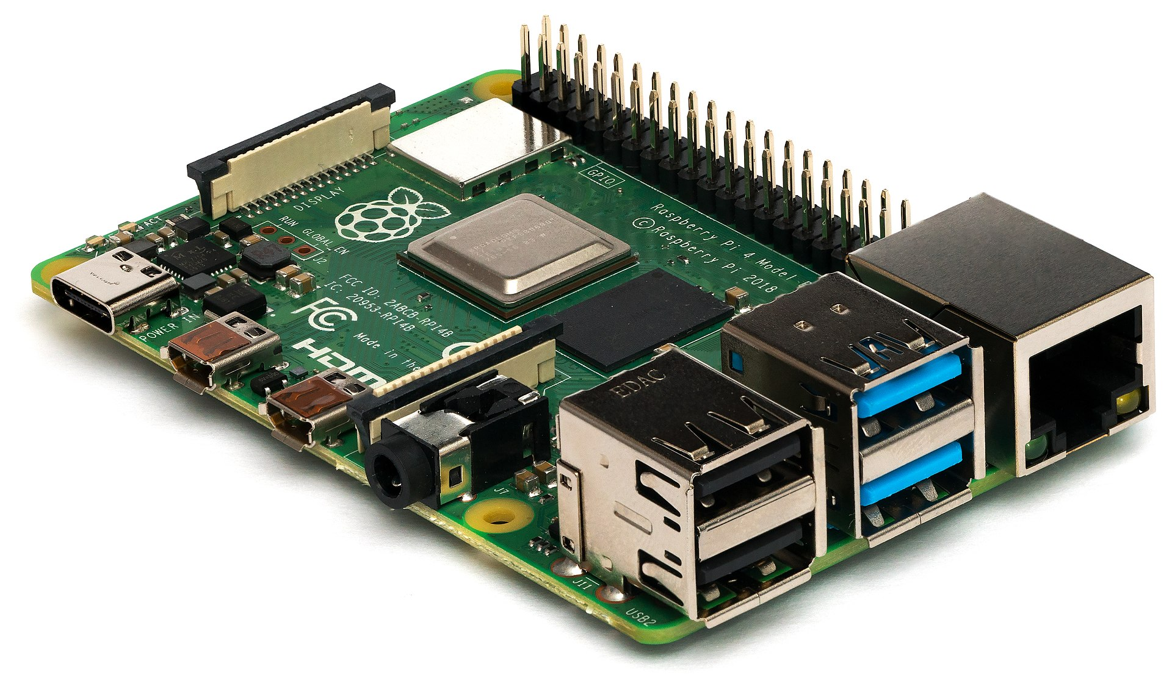

RASPBERRY PI
Raspberry Pi is a series of small single-board computers developed in the United Kingdom by the Raspberry Pi Foundation in association with Broadcom. The Raspberry Pi project originally leaned towards the promotion of teaching basic computer science in schools and in developing countries.
Raspberry pi is essentially an affordable credit card sized computer that can easily be plugged into a monitor and uses standard keyboard and mouse. It capable of performing all task you’d expect a normal desktop computer to do from Internet browsing, to running software like Word documents to programing with languages like Python and Scratch. It’s designed and made by the Raspberry pi foundation to make computer programing easy and accessible by kids and adults alike. It can Run Raspbian which is a Linux based OS, Windows 10 IoT core, Linux, Ubuntu core and others

Slide 6








THE EVER EXISTED OPERATING SYSTEMS

Slide 7
HOW THESE SYSTEMS WERE VULNERABLE?
What is CVE code?
short for Common Vulnerabilities and Exposures, is a list of publicly disclosed computer security flaws. When someone refers to a CVE, they mean a security flaw that's been assigned a CVE ID number.
Windows XP a breakthrough CVE-2010-0269 399 Exec Code (HAPPY HACKING!!!)
How these are found?
With help using metasplotiable framework which is one of the powerful tool in kali linux.
The Metasploit framework is a very powerful tool which can be used by cybercriminals as well as ethical hackers to probe systematic vulnerabilities on networks and servers. Because it’s an open-source framework, it can be easily customized and used with most operating systems.

Slide 8
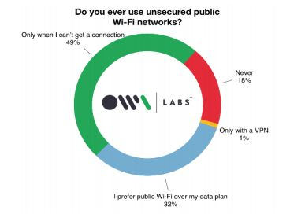
WHEN ARE THE SYSTEMS MORE VULNERABLE?
An amazing growth in the bandwidth and
speed available to the end user from 1995 till the end of 2016
the Internet users have grown from 16,000,000 to more than
3000 million.
According to Norton Report, they found that 68% of public
Wi-Fi users are vic-tims to cybercrimes, “It can be abused to
steal sensitive information such as credit card numbers,
passwords, chat messages, emails, photos and so on

Slide 9
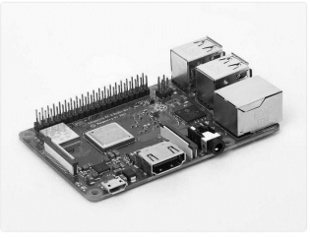
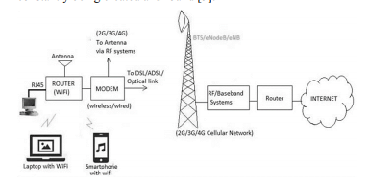
Technical Specification Include
1.4GHz 64-bit quad-core
processor, dual-band wireless LAN, Bluetooth 4.2/BLE, faster
Ethernet, and Power-over-Ethernet support (with separate PoE
HAT).
Stored Kali Linux ARM Image version
2019.4 for Raspberry Pi 3 on a 32GB SanDisk extreme micro
SD card.

Slide 10
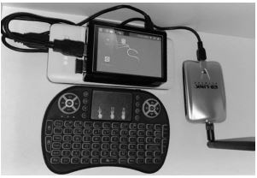
Overview of (powerful) pocket system
Attached a TFT LCD screen to the Raspberry Pi.
Then we inserted the micro SD card into the Raspberry Pi
plugged the Pi to a monitor via HDMI cable and powered it up
using an external 30000mAh power bank. Once the OS booted
up, we plugged in our mini keyboard that has a touchpad for
screen control.

Slide 11
Steps Monitor MODE
Enter Monitor Mode: enable monitor mode on the Wi-Fi adapter to capture ALL Wireless traffic.
By inputting this code into a terminal:
ifconfig
To see the network interfaces. You should be
choosing the wireless one.
airmon-ng check kill
To kill the processes that could interfere with the
airmon-ng suite.
airmon-ng start wlan0
where wlan0 is the wireless interface.

Slide 12
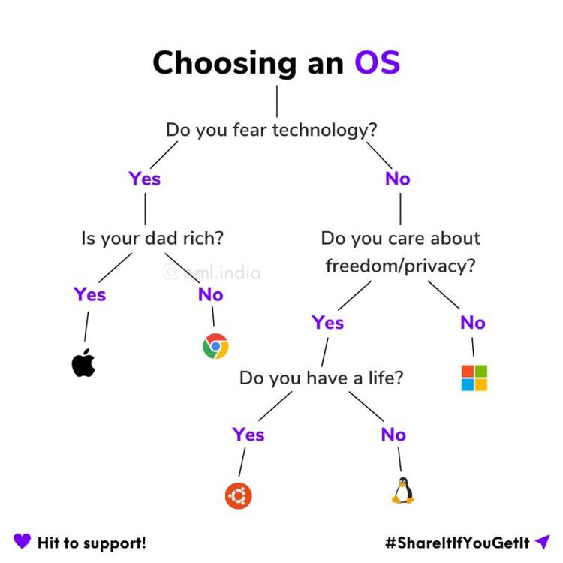
HOW LINUX IS IMPORTANT ?

Slide 13

GUESS WHO ?

Slide 14


Slide 15

THANK YOU
Email-az1234im@gmail.com

